Slide 1

N26 Forecasting Project
Idreece Khan

Slide 2

The task was to produce a forecast of income an expenditure for a sample of 10k customers. I was given data for February – July 2016 and asked to produce my forecast for August

Slide 3

Data Preparation

Slide 4
Data Preparation
The First thing I do in such a task is check, nulls, duplicates and outliers
Nulls
The data was complete. The Master card category did have null values however these are only relevant for outgoing card payments and in this case where these were relevant the data was complete
Duplicates
There were a significant number of duplicate outgoing payments, about 10k transactions, without a transaction ID, I was able to get confirmation from the data owner that I should remove these
Outliers
The data did contain quite a lot of outliers, however given the nature of the data it is perfectly possible that the distribution income and expenditure is correct, and I couldn’t see anything outlandish

Slide 5
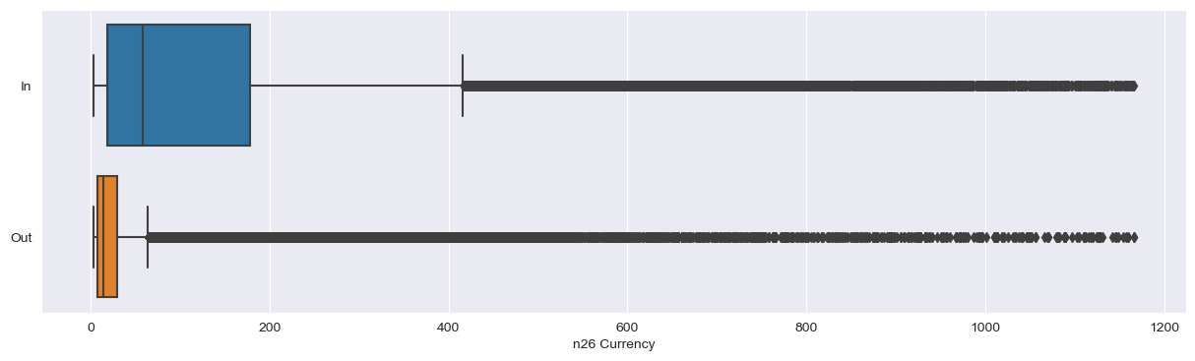
The box and whisker plot below for income and outgoings clearly show the present of outliers. With financial data you would expect this kind of distribution. In the real world you might want to investigate some of the really big values. Given these are synthetic units it is really difficult to identify if anything is really out of the ordinary. I made the assumption that it is fine to keep these in the data

Slide 6
Exploratory Data Analysis

Slide 7
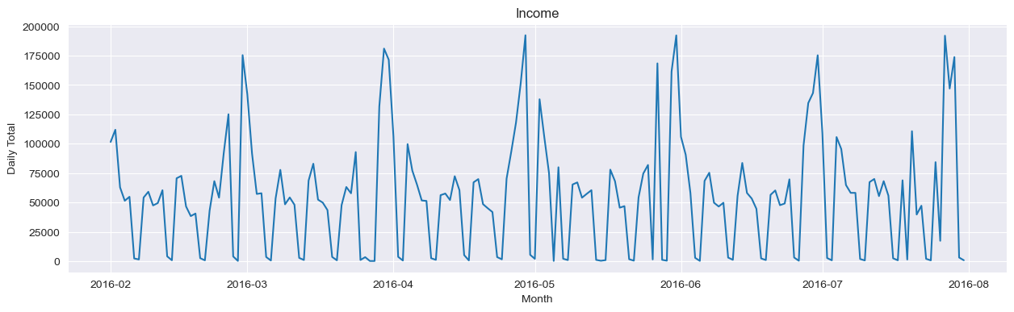
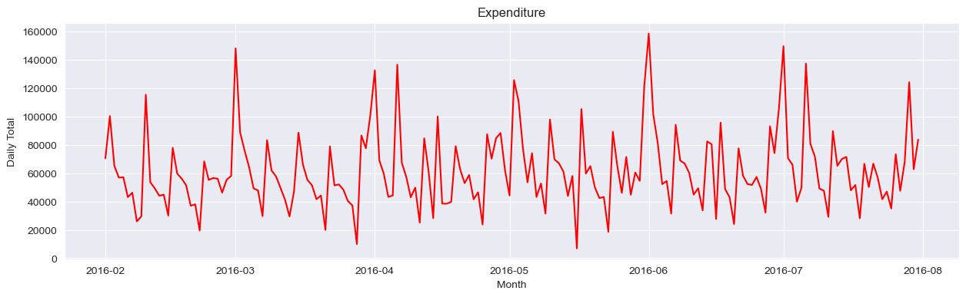
Looking at the plot of income and outcome over time we can immediately see two things.
There doesn’t seem to be along term trend
There is Seasonality in the data, both daily and monthly, particularly pronounced in the income data

Slide 8
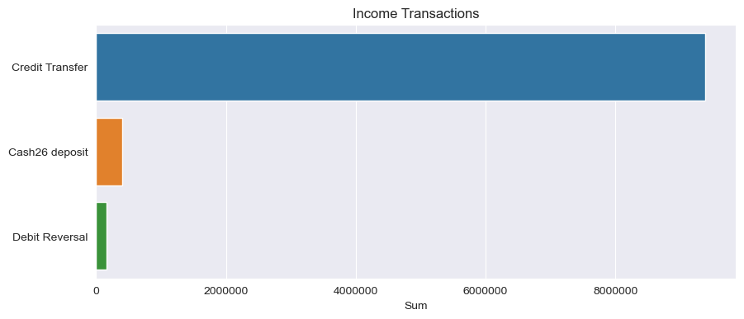
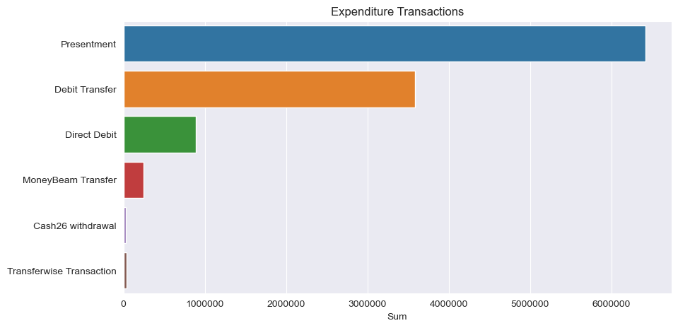
The breakdown of income transactions that these are all primarily credit transfers, also immediately suggests that it doesn’t make sense cutting income up for forecasting
The breakdown of expenditure transactions also shows that the data in imbalanced however It is reasonable to assume the three biggest groups will have different patterns

Slide 9
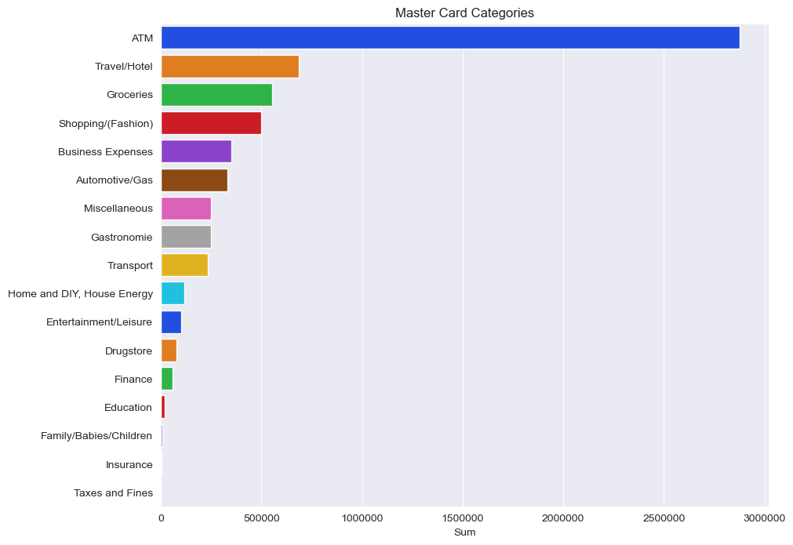
The majority are card payments are ATM withdrawals, so again imbalance.
Before going deciding how to forecast expenditure I want to see how some of the categories evolve over time

Slide 10
The majority are card payments are ATM withdrawals, so again imbalance.
Before going deciding how to forecast expenditure I want to see how some of the categories evolve over time

Slide 11
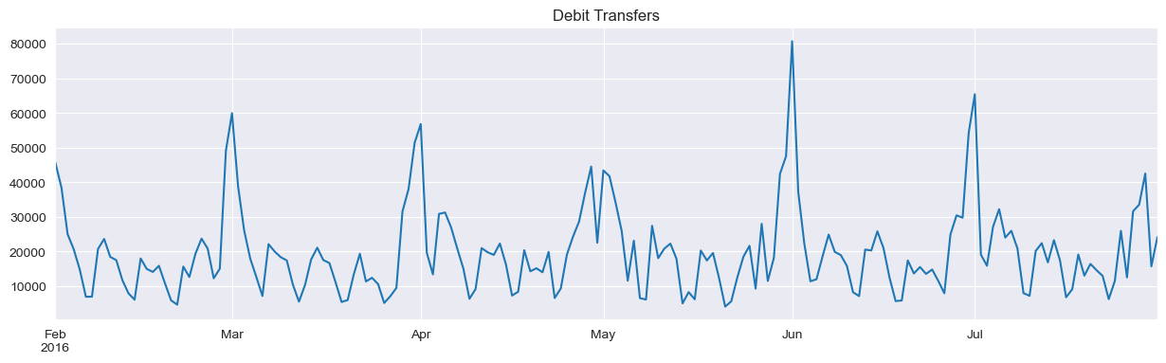
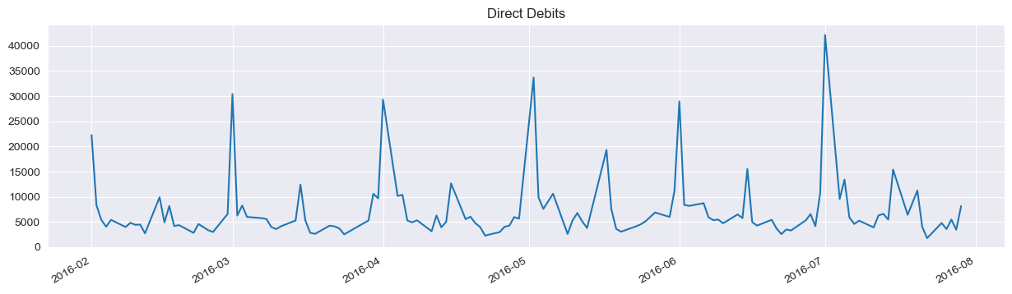
Categories with strong seasonality

Slide 12
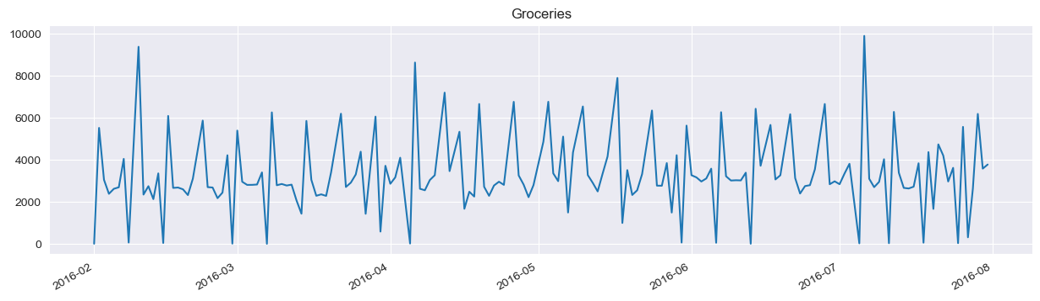
Categories with strong seasonality
Based on evidence from the data I decided to model income aggregated as a whole with expenditure broken down into direct debits, debit transfers, groceries and everything else

Slide 13
Time Series Forecasting

Slide 14
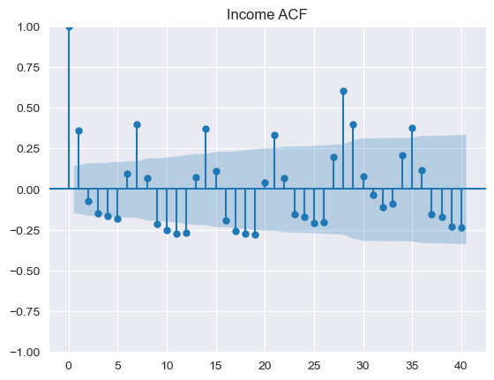
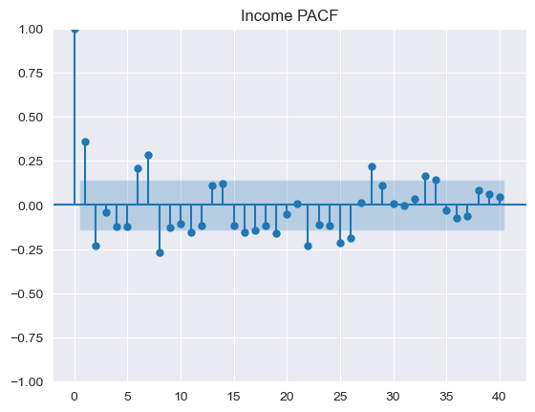
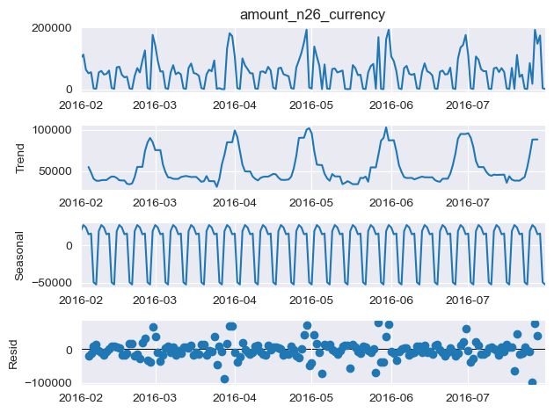
Modelling The charts below show income data but the process was repeated for expenditure with broadly similar results, for full view of all charts see accompanying notebook
Dicky fuller unit root test fails to reject null that there is long term trend, ACF, PACF and ETS decomposition support my initial view that there is both monthly and weekly seasonality
Augmented Dicky Fuller | -3.91
P-Value (95% confidence interval) | 0.002

Slide 15
Modelling Approach
Classical time series approach with ARIMA models (Not enough data for deep learning)
Used the pmdarima package to help me select the best time series model form
Added exogenous X variables to help account for monthly spikes for income, direct debits and debit transfers
In some cases I manually adjusted the model selected from the auto arima function in pmdarima adding a 1 to the capital P seasonal parameter. In all cases I believe this improved the model
For training data was split into test train sample with July used as test data, also computed RMSE and MAE in conjunction with model output

Slide 16
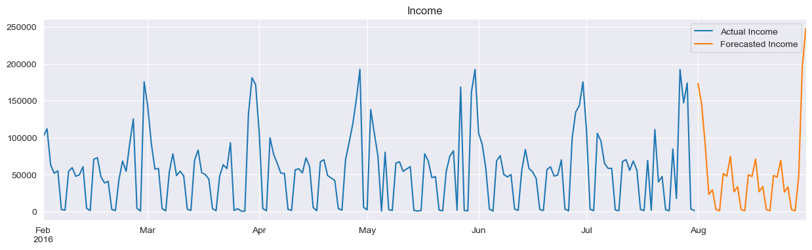
Forecast - Income
1
2
3
4
5

Slide 17
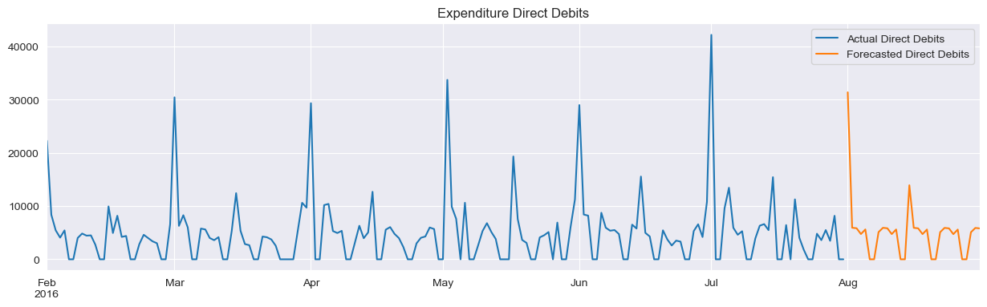
Forecast – Expenditure Direct Debits
1
2
3
4
5

Slide 18
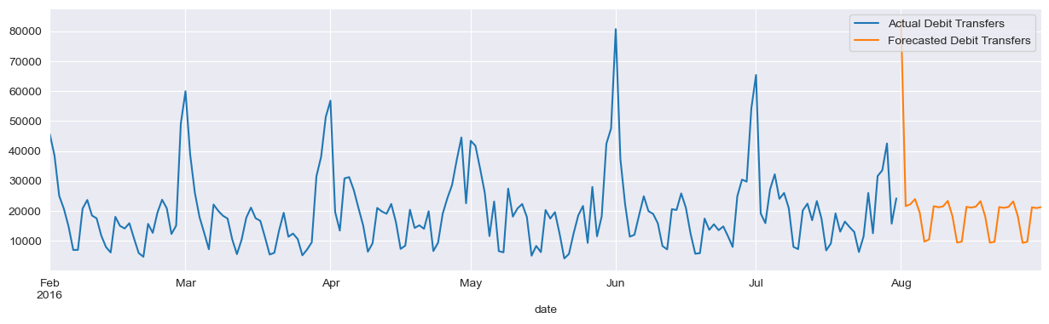
Forecast – Expenditure Debit Transfers
1
2
3
4
5

Slide 19
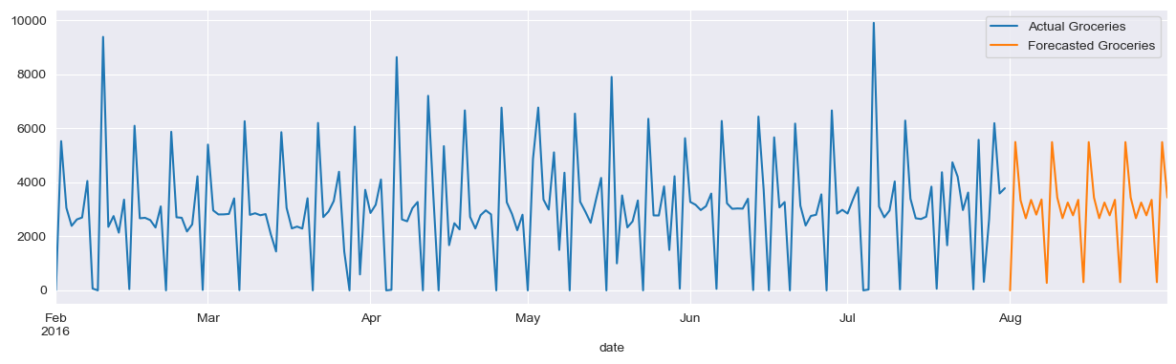
Forecast – Expenditure Groceries
1
2
3
4
5

Slide 20
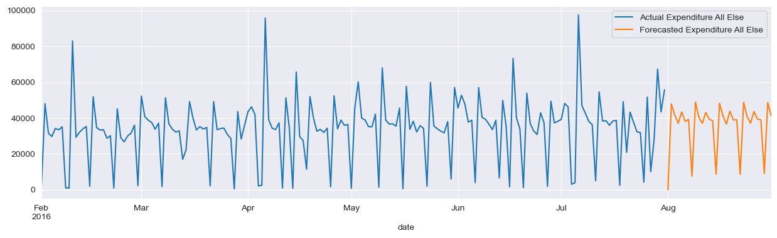
Forecast – Expenditure Everything Else
1
2
3
4
5

Slide 21
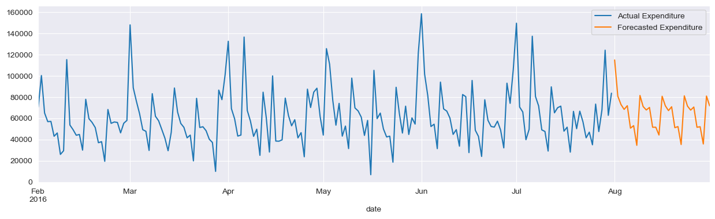
Final Expenditure Forecast
The total of the individual expenditure forecasts produces a total which doesn’t look too far off, missing some of the spikes but still ok. I think a pretty decent model given the time available.

Slide 22
Concluding Remarks

Slide 23
Will the models consistently perform well?
Given the data I think the model won’t be too far off for August however there are major improvements that can be made
The data set is quite small, we identified that there are monthly spikes, however not enough data for even one 12 cycle and not enough to forecast spike for holiday days
Different groups of customers will likely use the platform differently and we could potentially improve our forecasts by forecasting groups separately

